Slide 1
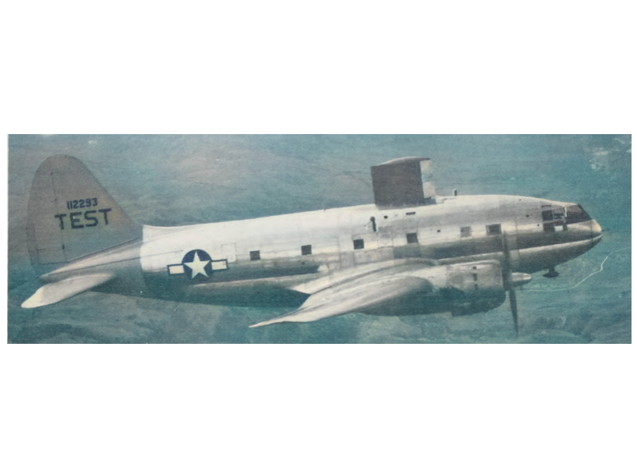

Aircraft Ice Protection in the
NACA Era
1915 to 1958
apps.dtic.mil
From "NACA Conference on Aircraft Ice Prevention A Compilation of Papers Presented by NACA Staff Members" 6505/NACA-1947/8, 1947 (colorized)
A Presentation to the FAA Aircraft Icing Forum
May 13, 2025
CC BY-NC-SA 4.0 2025 by Donald Cook.
All images are Public Domain.
Notes:
In the coming months, the Aircraft Icing Forum will present current aircraft icing technology and challenges.
Here, I will present “old news” which is the basis of our current understanding of icing.
“Every thing was known by 1947”
Well, that is not quite true, but a remarkable progress was made in the NACA era.
We will also meet a Collier Trophy winner and a Nobel Prize winner.

Slide 2

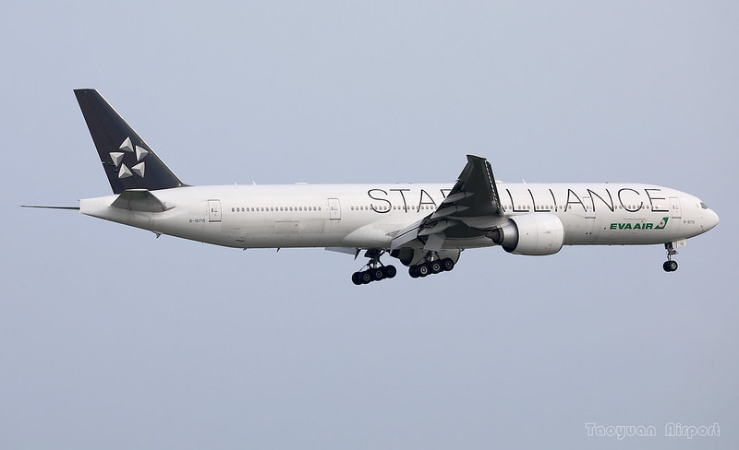
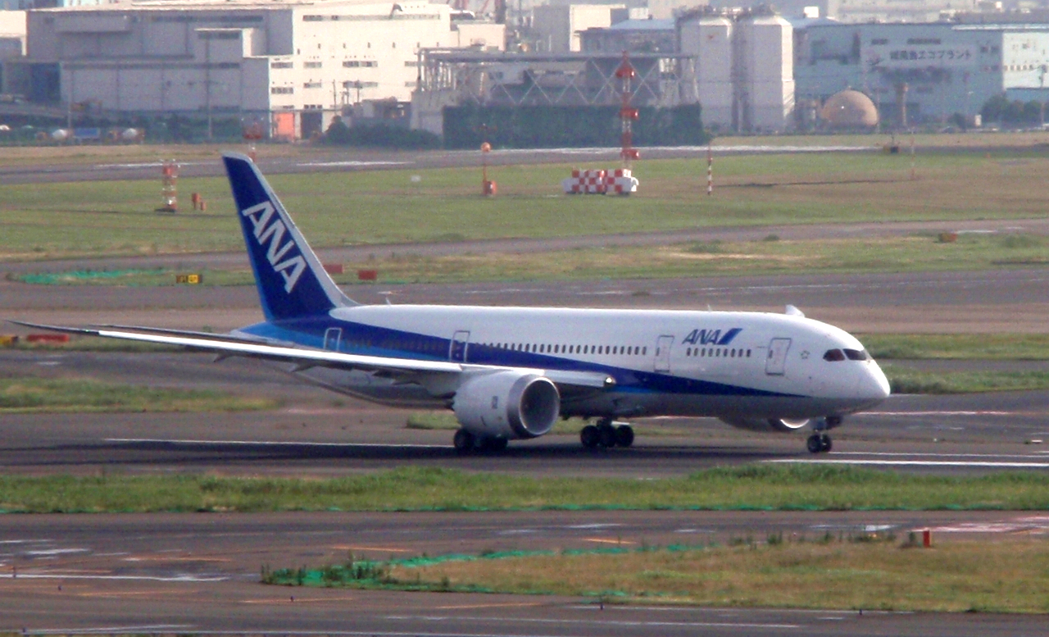
Don Cook
- Over 30 years experience in aircraft icing
- Served on industry committees (AIAA, SAE, other)
- Currently blogging at icinganalysis.com about icing in the NACA era
High altitude, long endurance aircraft
777
787
Did not win contract
https://www.nasa.gov/aeronautics/global-hawk-uas/
https://www.flickr.com/photos/zx4142/27961073368/
https://freeaircraftimages.blogspot.com/2013/02/boeing-787-dreamliner.html
Notes:
While the team that I was on did not win the high altitude, long endurance aircraft contract, I learned how to use LEWICE, and about icing environments beyond typical “Appendix C” icing conditions.
On the 777 program I was the equipment manager for the engine and wing ice protection systems. I conducted numerous icing tunnel and natural icing flight tests.
On the 787 program, I lead the technology development for the electrothermal wing ice protection.

Slide 3
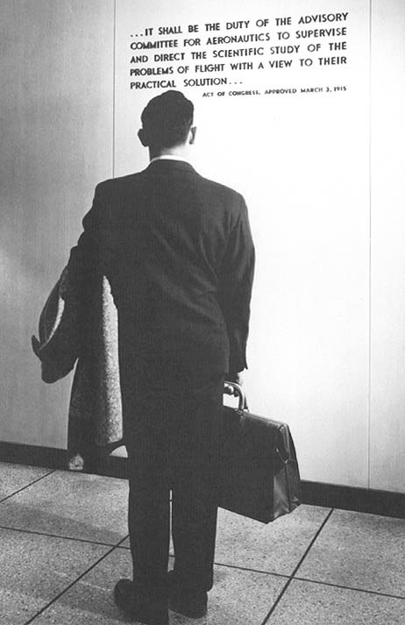
The National Advisory Committee for Aeronautics
Operated from 1915 to 1958
There where numerous achievements in aeronautics,
of which aircraft ice protection was only one area
Became part of National Aeronautics and Space Administration (NASA) in 1958
commons.wikimedia.org
Notes:
"… it shall be the duty of the advisory committee for aeronautics to supervise and direct the scientific study of the problems of flight with a view to their practical solution"
Other NACA achievements:
NACA standardized airfoils
Supercharged aircraft engines
Supersonic flight

Slide 4
Progress over the NACA Era
“Investigation revealed the trouble to have been caused by the collection of snow somewhere between the entrance to the carburetor and the manifold …”
- NACA-TN-55, “Airplane Crashes: Engine Troubles. A Possible Explanation.”, 1921. ntrs.nasagov
“Transcontinental and transatlantic flying over the northern route can never be entirely safe until a problem (icing) which has thus far baffled ingenuity has been solved.”
- Commentary on attempts to solve icing problems, New York Times, April 9, 1931
"Aircraft are now capable of flying in icing clouds without difficulty, however, because research by the NACA and others has provided the engineering basis for icing protection systems"
- “The Icing Problem”, presented at Ottawa AGARD Conference. AG 19/P9, June 10-17 1955
ntrs.nasa.gov
Notes:
NACA-TN-55 "A demon was operating the throttle."
NACA induction-system icing program, 1941
A NACA conference in 1947 detailed ice protection solutions.

Slide 5
Ice protection as an enabler
By 1941, a modified Lockheed 12A with complete ice protection was demonstrated.
In 1946, Lewis A. Rodert, Chief of the Flight Research Branch at the Cleveland Laboratory of the National Advisory Committee for Aeronautics, was awarded the Collier Trophy: “For his pioneering research and guidance in the development and practical application of a thermal ice prevention system for aircraft.”
Weather capable aircraft, along with highly developed analysis methods for the rotating multicylinder instrument, enabled measurements of natural icing conditions.
By 1947, flight test data that established much of the CFR 25, Appendix C icing regulation was completed.
By 1955 CAM 4b was published (including a predecessor to CFR 25 Appendix C), establishing the modern era of ice protection requirements.
Notes:
Effective ice protection was achieved prior to understanding the icing environment.
However, to reliably engineer solutions to other aircraft, data about the icing environment is required.

Slide 6
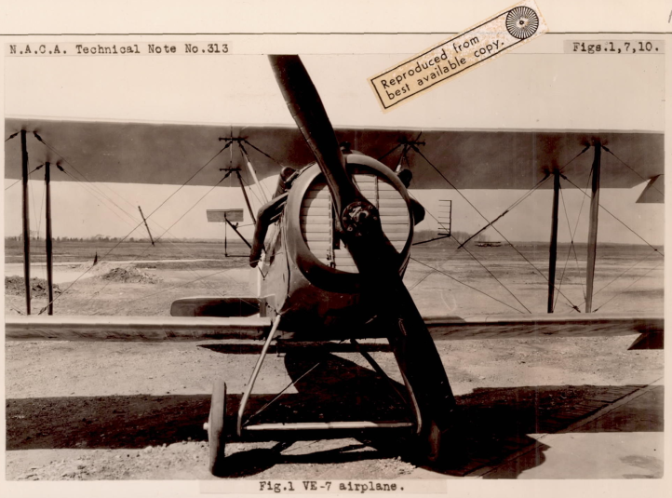
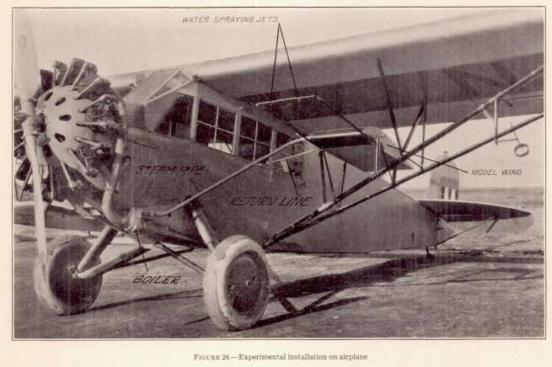
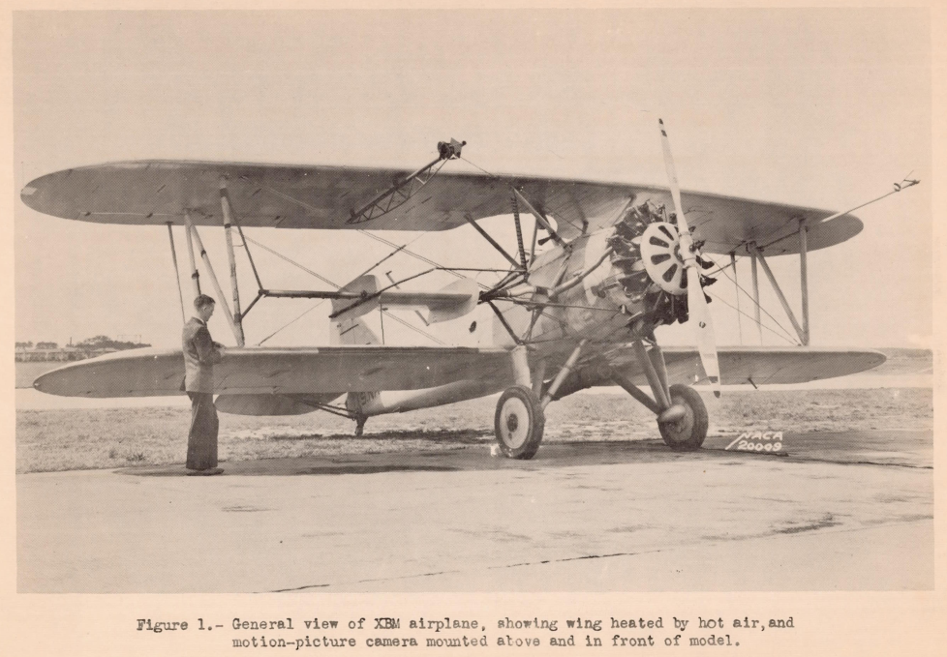
Early Flight Test Aircraft
"an airplane that will be immune from the dangers of ice accumulation ... is only a matter of technical development."
NACA-TR-403
Vought E-7, 1929
Fairchild FC-2, 1931
XBM, 1938
NACA-TN-313
NACA-TR-403
NACA-TN-783
Notes:
Several aircraft were used in early icing flight research.
Some of the test aircraft had little to no ice protection.
These often used a water spray mounted ahead of a test airfoil to simulate natural icing conditions.

Slide 7
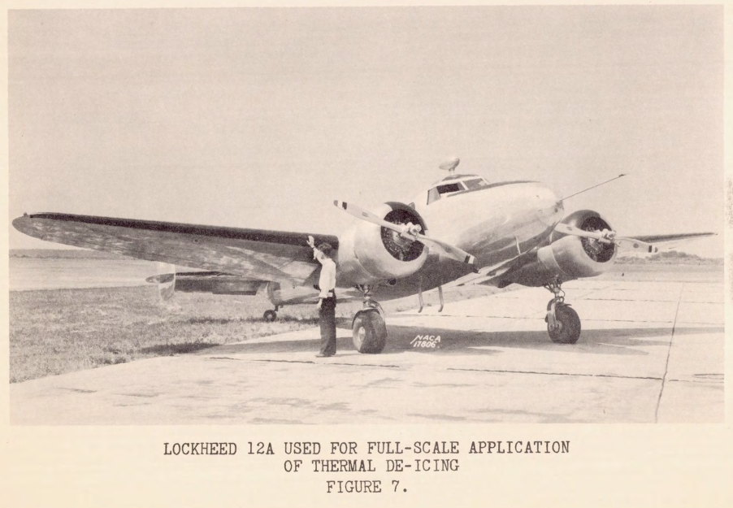
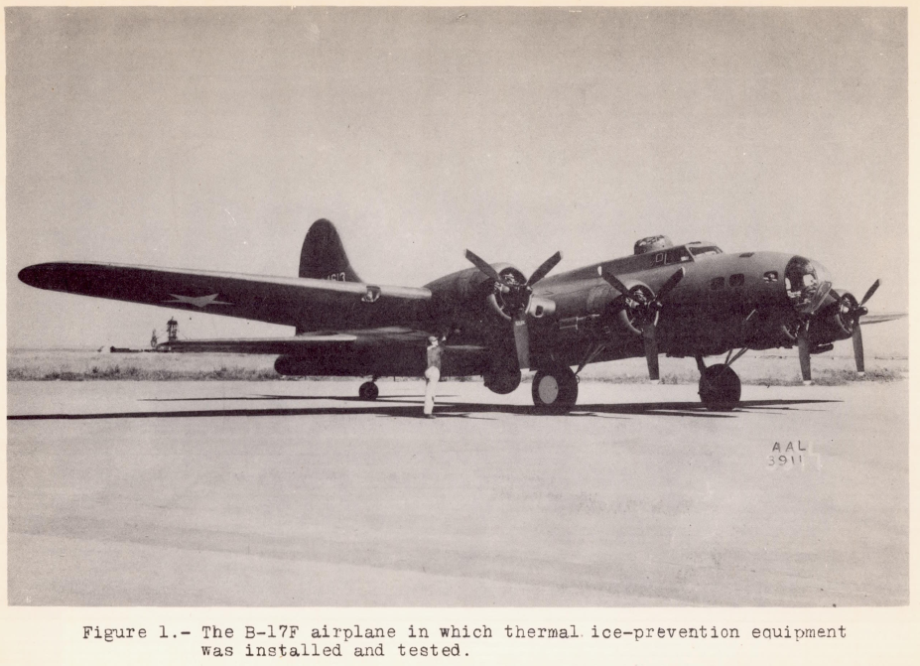
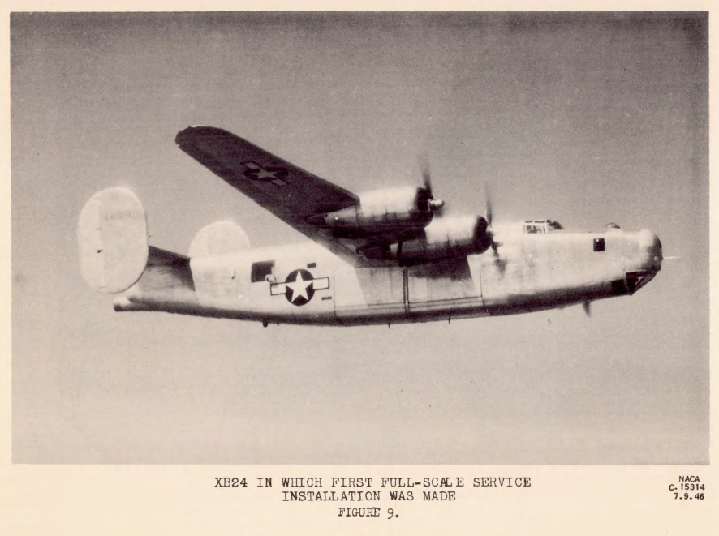
Ice Protection Development
Flight Test Aircraft
Lockheed 12A, 1941
B-17F, 1943
Consolidated XB-24, 1943
apps.dtic.mil
NACA-ARR-3H24
apps.dtic.mil
Notes:
By 1943 several aircraft were equipped with effective ice protection.
The development was largely “cut-and-try” engineering or “practical solution”, rather than “scientific study”

Slide 8
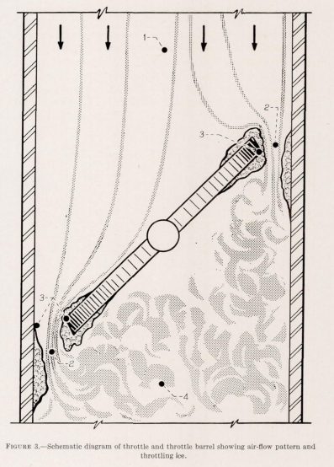
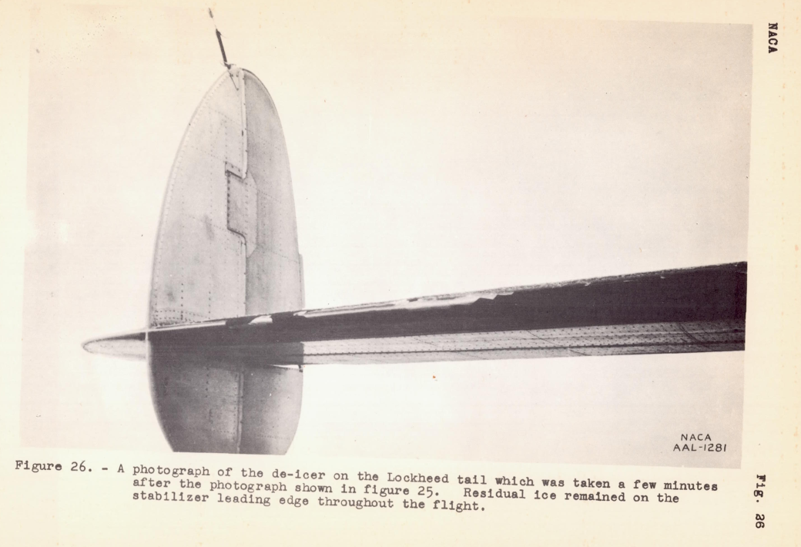
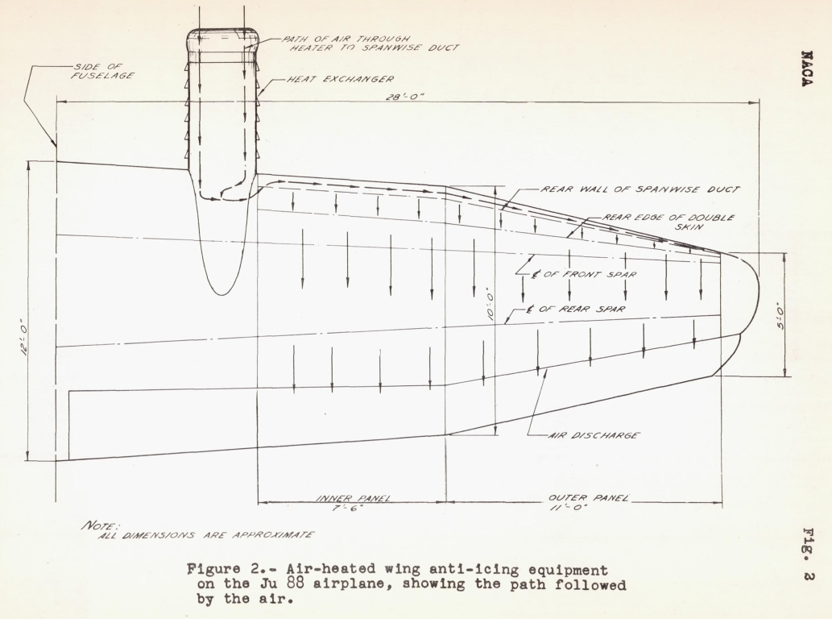
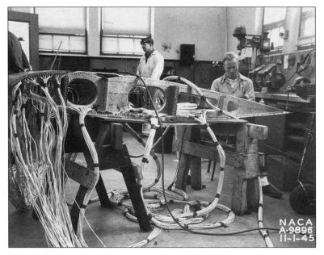
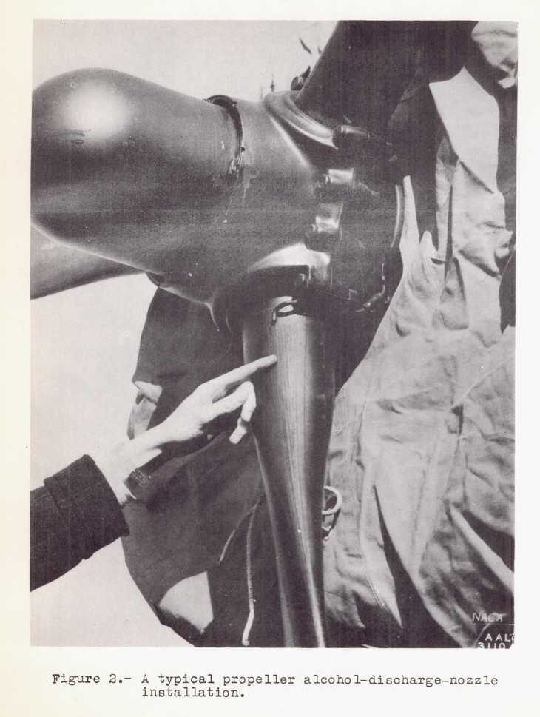
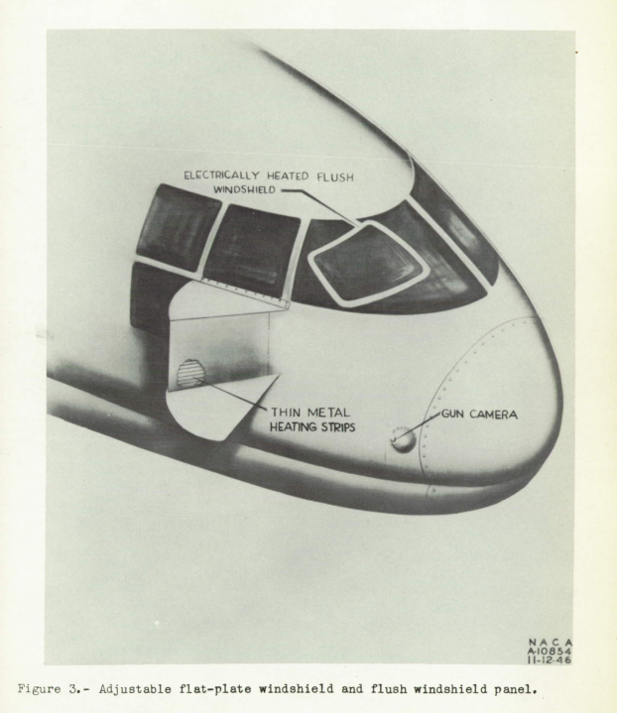
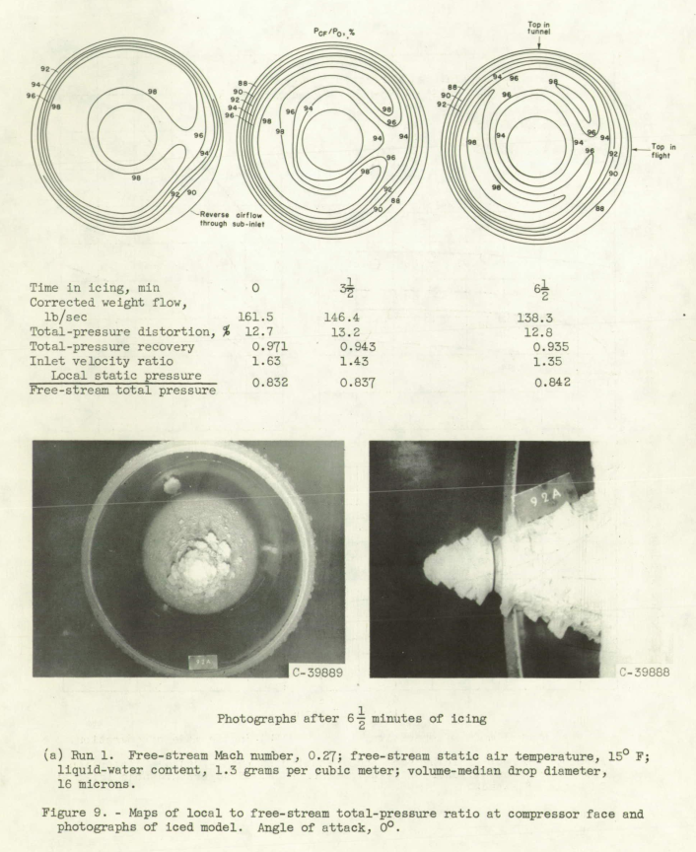
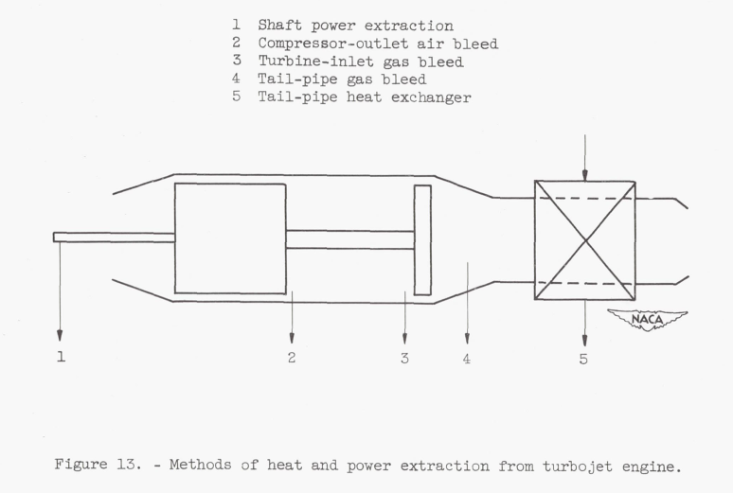
Ice Protection
"I am surprised to find that there are so many details which have not been anticipated before the de-icing tests were started."
ntrs.nasa.gov
Carburetor
Pneumatic Boots
Exhaust Heat
Electrothermal
NACA-TR-982
NACA-WR-A-53
NACA-WR-A-39
NASA SP-4219
NACA-RB-4F06
NACA-TN-1434
NACA-RM-E57G09
Alcohol
NACA-TN-2866
Compressed Air
Inlets
Windshields
Ice protection icinganalysis.com
Notes:
Several components have ice protection, and the modes of protection may differ.
The Electrothermal image is the internals of the fin in the image on slide 1. There are numerous, individually controlled electrothermal heater strips that were used to study heat transfer in flight.

Slide 9
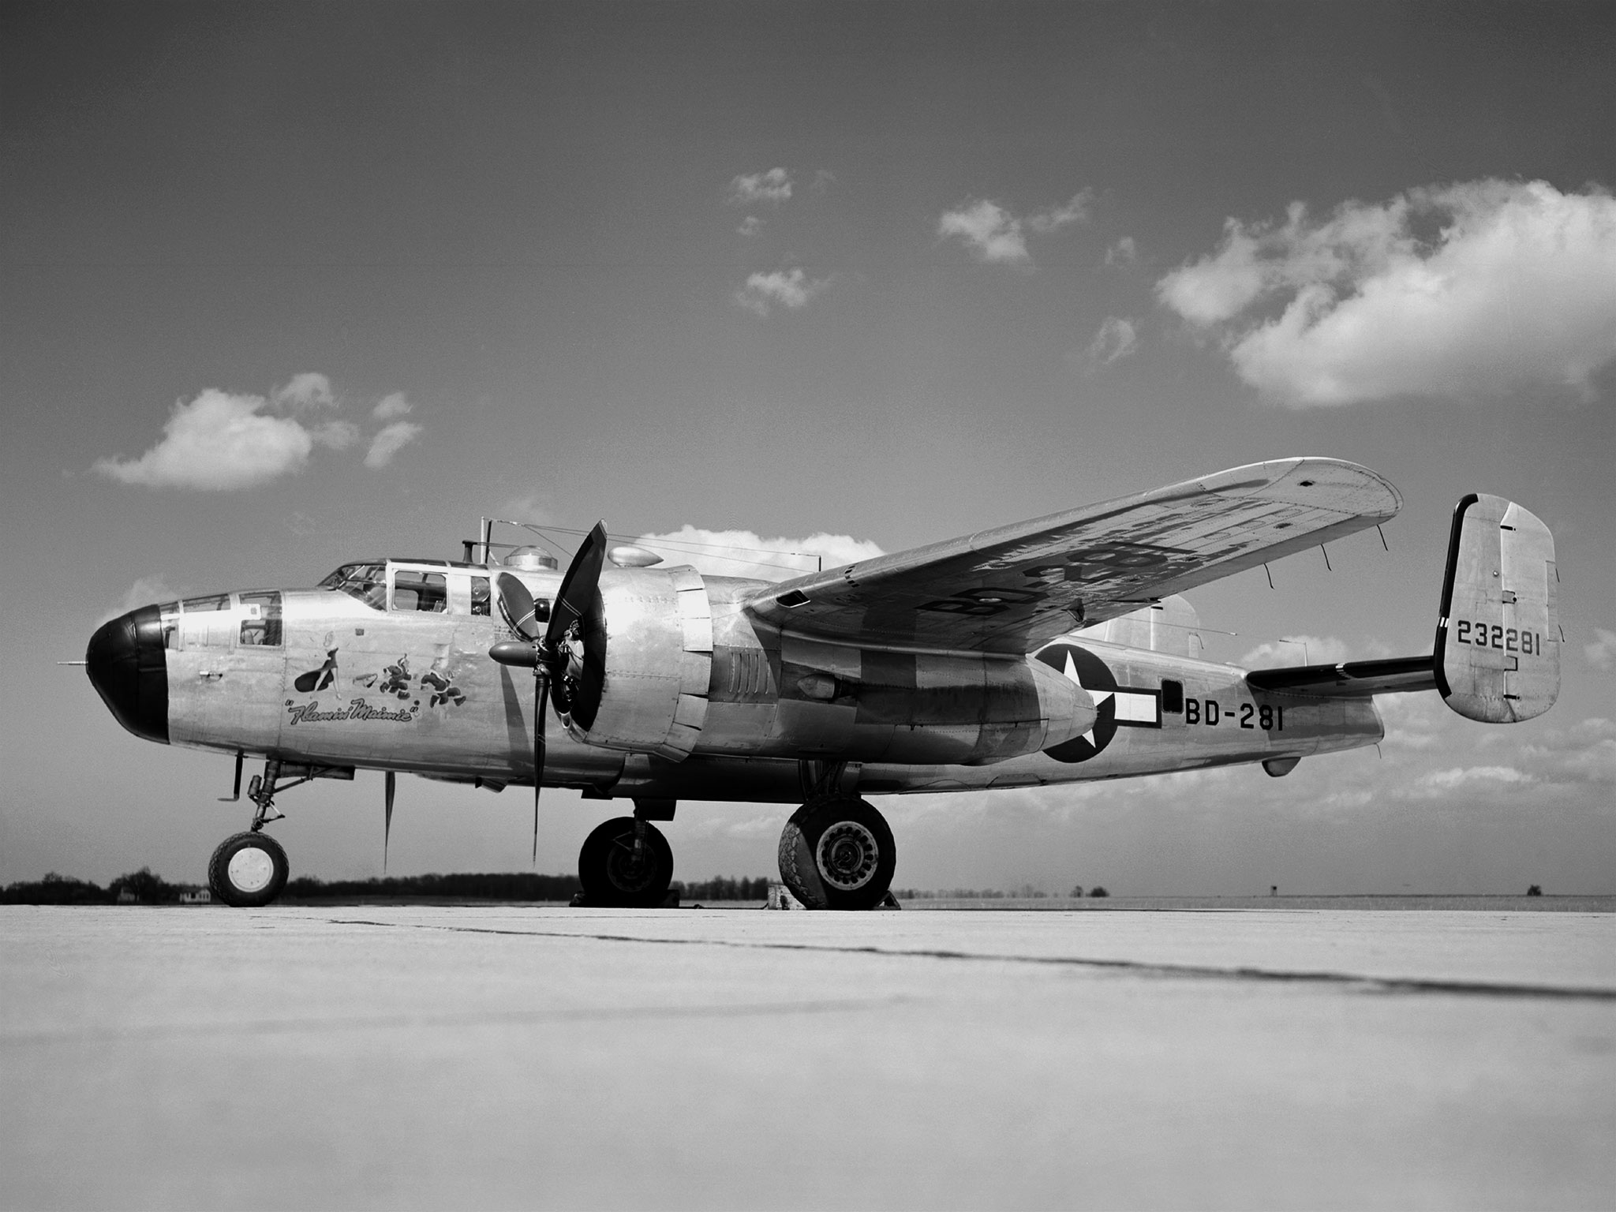
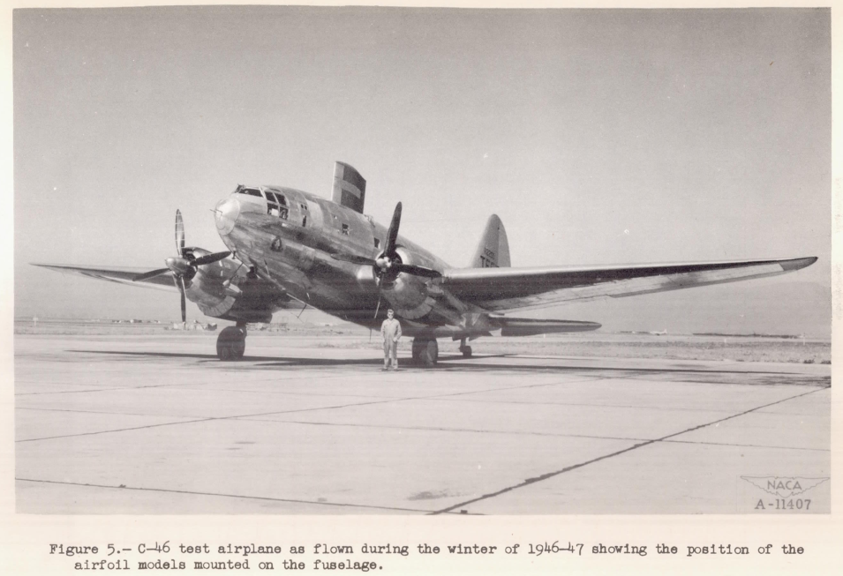
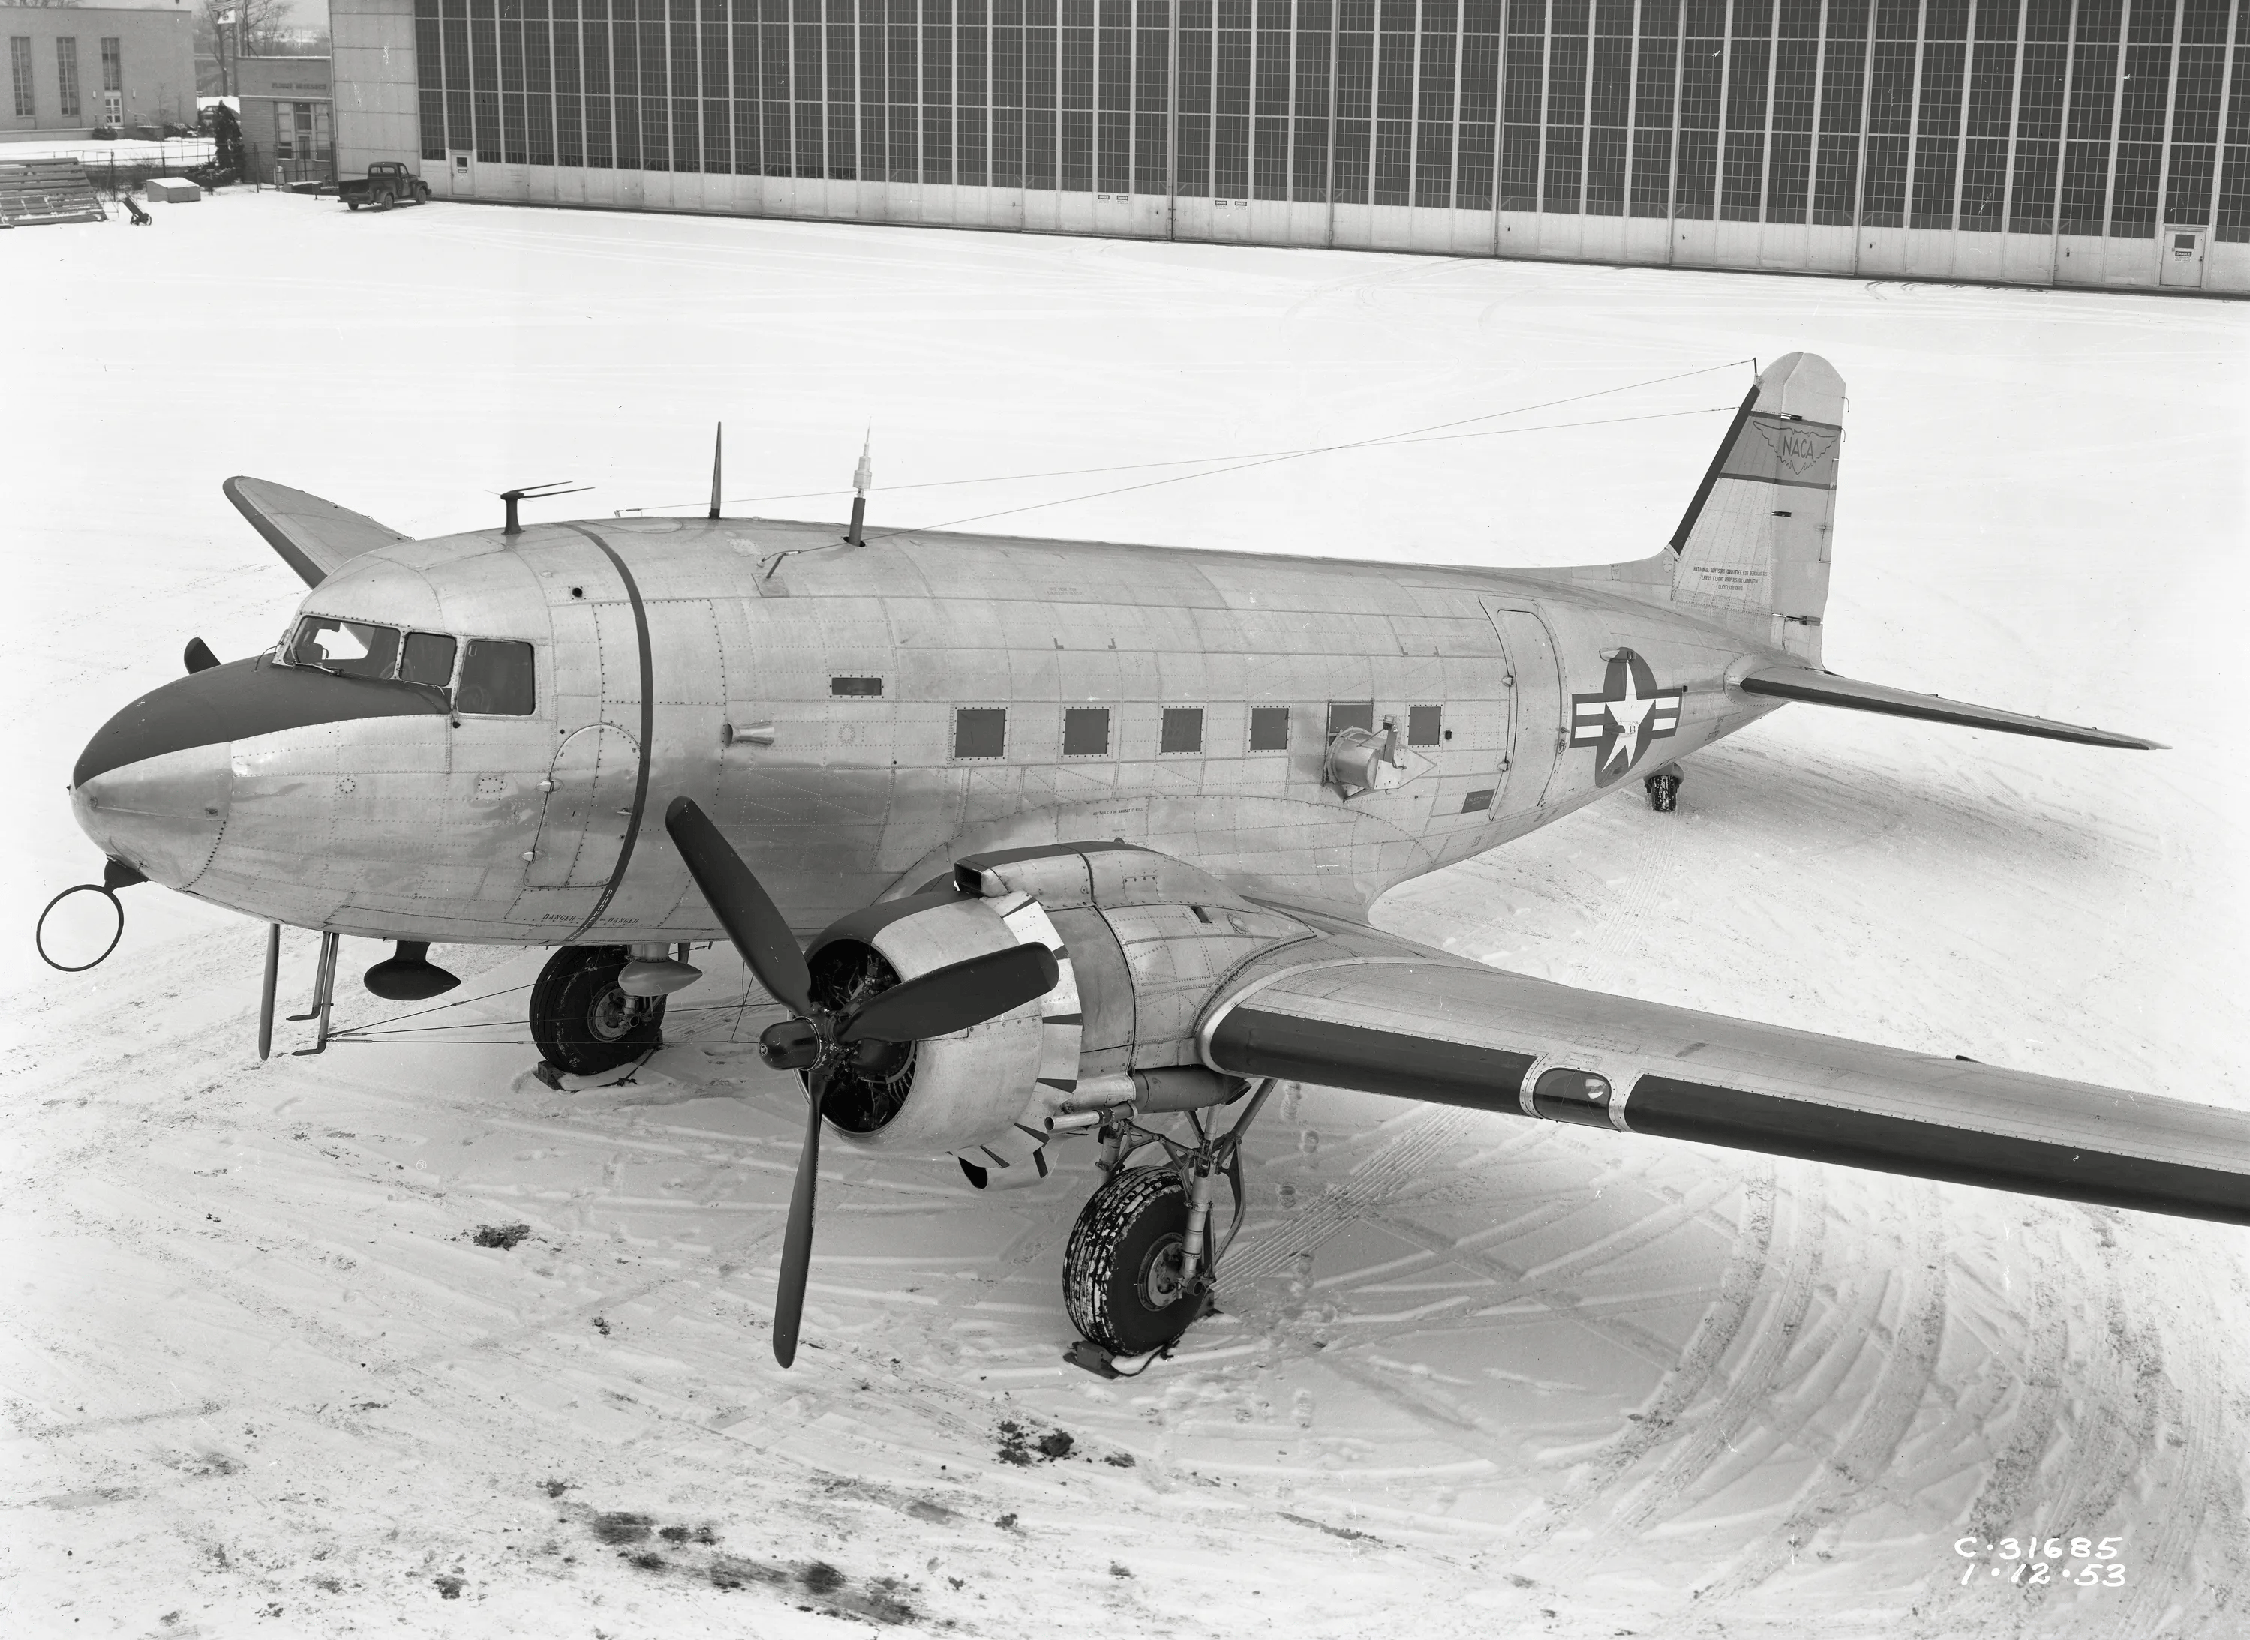
Instrumented Flight Test Aircraft
“Without extensive data on the problem that nature presents, the design of the thermal system can only be approached in an empirical manner”
Rodert 1947 apps.dtic.mil
North American XB-25E, 1942
Curtis C-46, 1945
Douglas C-47, 1946
NACA-TN-1472
nasa.gov
nasa.gov
Notes:
These, and several other aircraft, soon produced “extensive data”.
The XB-25E is the “Flamin Mamie”. One NASA site described the artwork as “depicting a fiery woman chasing off icing researchers”

Slide 10
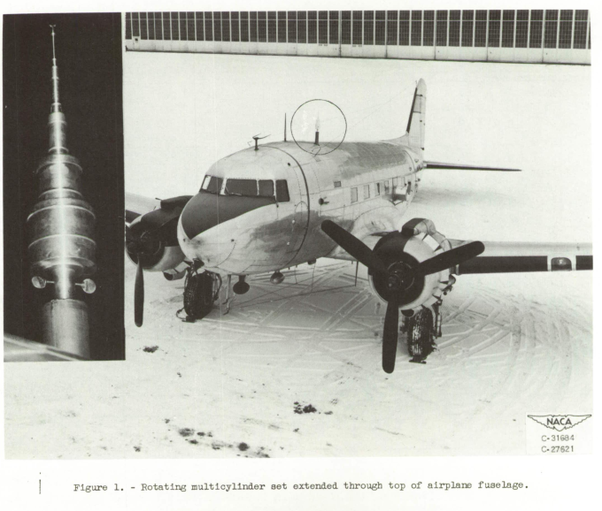
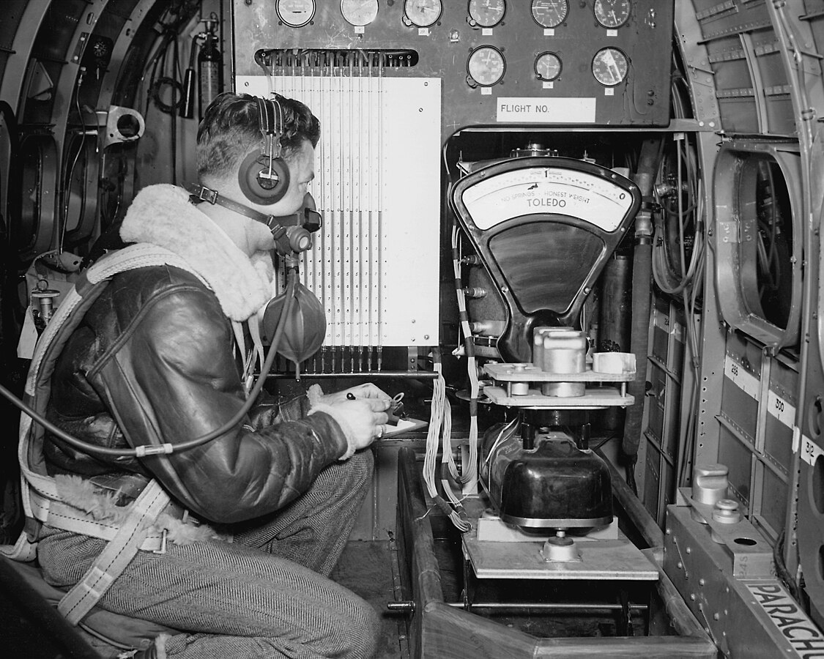
The Rotating Multicylinder Instrument
NACA-RM-E53D23
wikimedia.org
Notes:
The rotating multicylinder was the primary instrument for measuring icing conditions liquid water content, average water drop size, and size distribution.
The multicylinders would be exposed in flight to icing conditions for 1 to 5 minutes. The were then withdrawn, separated, and individually weight and measured.

Slide 11
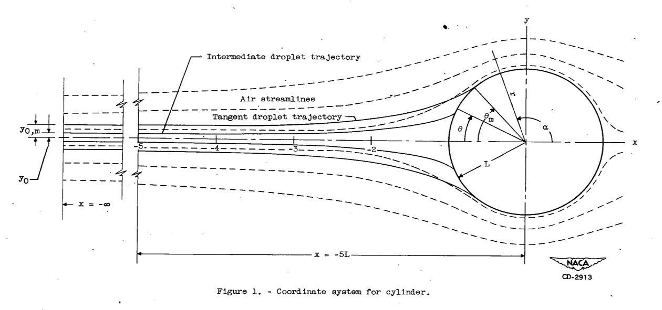
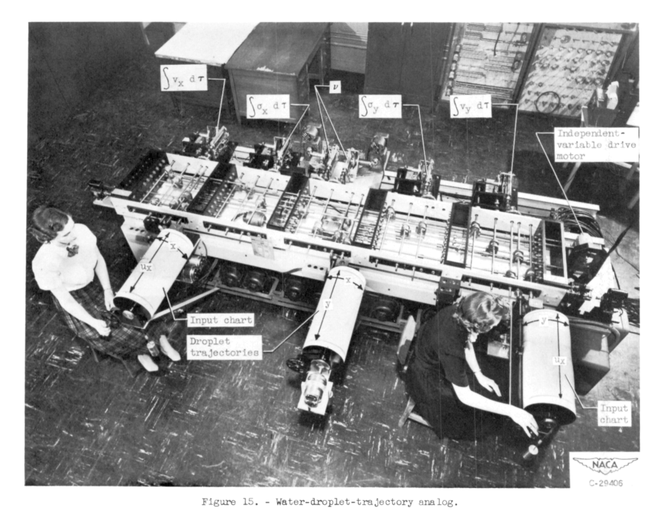
Water Drop Impingement Analysis
"The rotating-cylinder method ... is generally regarded as being the most accurate and dependable procedure thus far developed"
NACA-TN-1393
Water drop trajectory analysis about a cylinder was well-established by 1945.
Water drop trajectories were analyzed using two-dimensional equations of motion.
NACA-TN-2903
NACA-TN-2904
Mechanical computers were used to integrate the equations (the Differential Analyzer)
These calculations allowed measurements of multicylinder flight data to determine liquid water content, average drop sizes, and drop size distribution.
cylinders icinganalysis.com
Notes:
Irving Langmuir’s “Mathematical Calculation of Water Drop Trajectories” (1945), a remarkable analysis, established a firm basis.

Slide 12
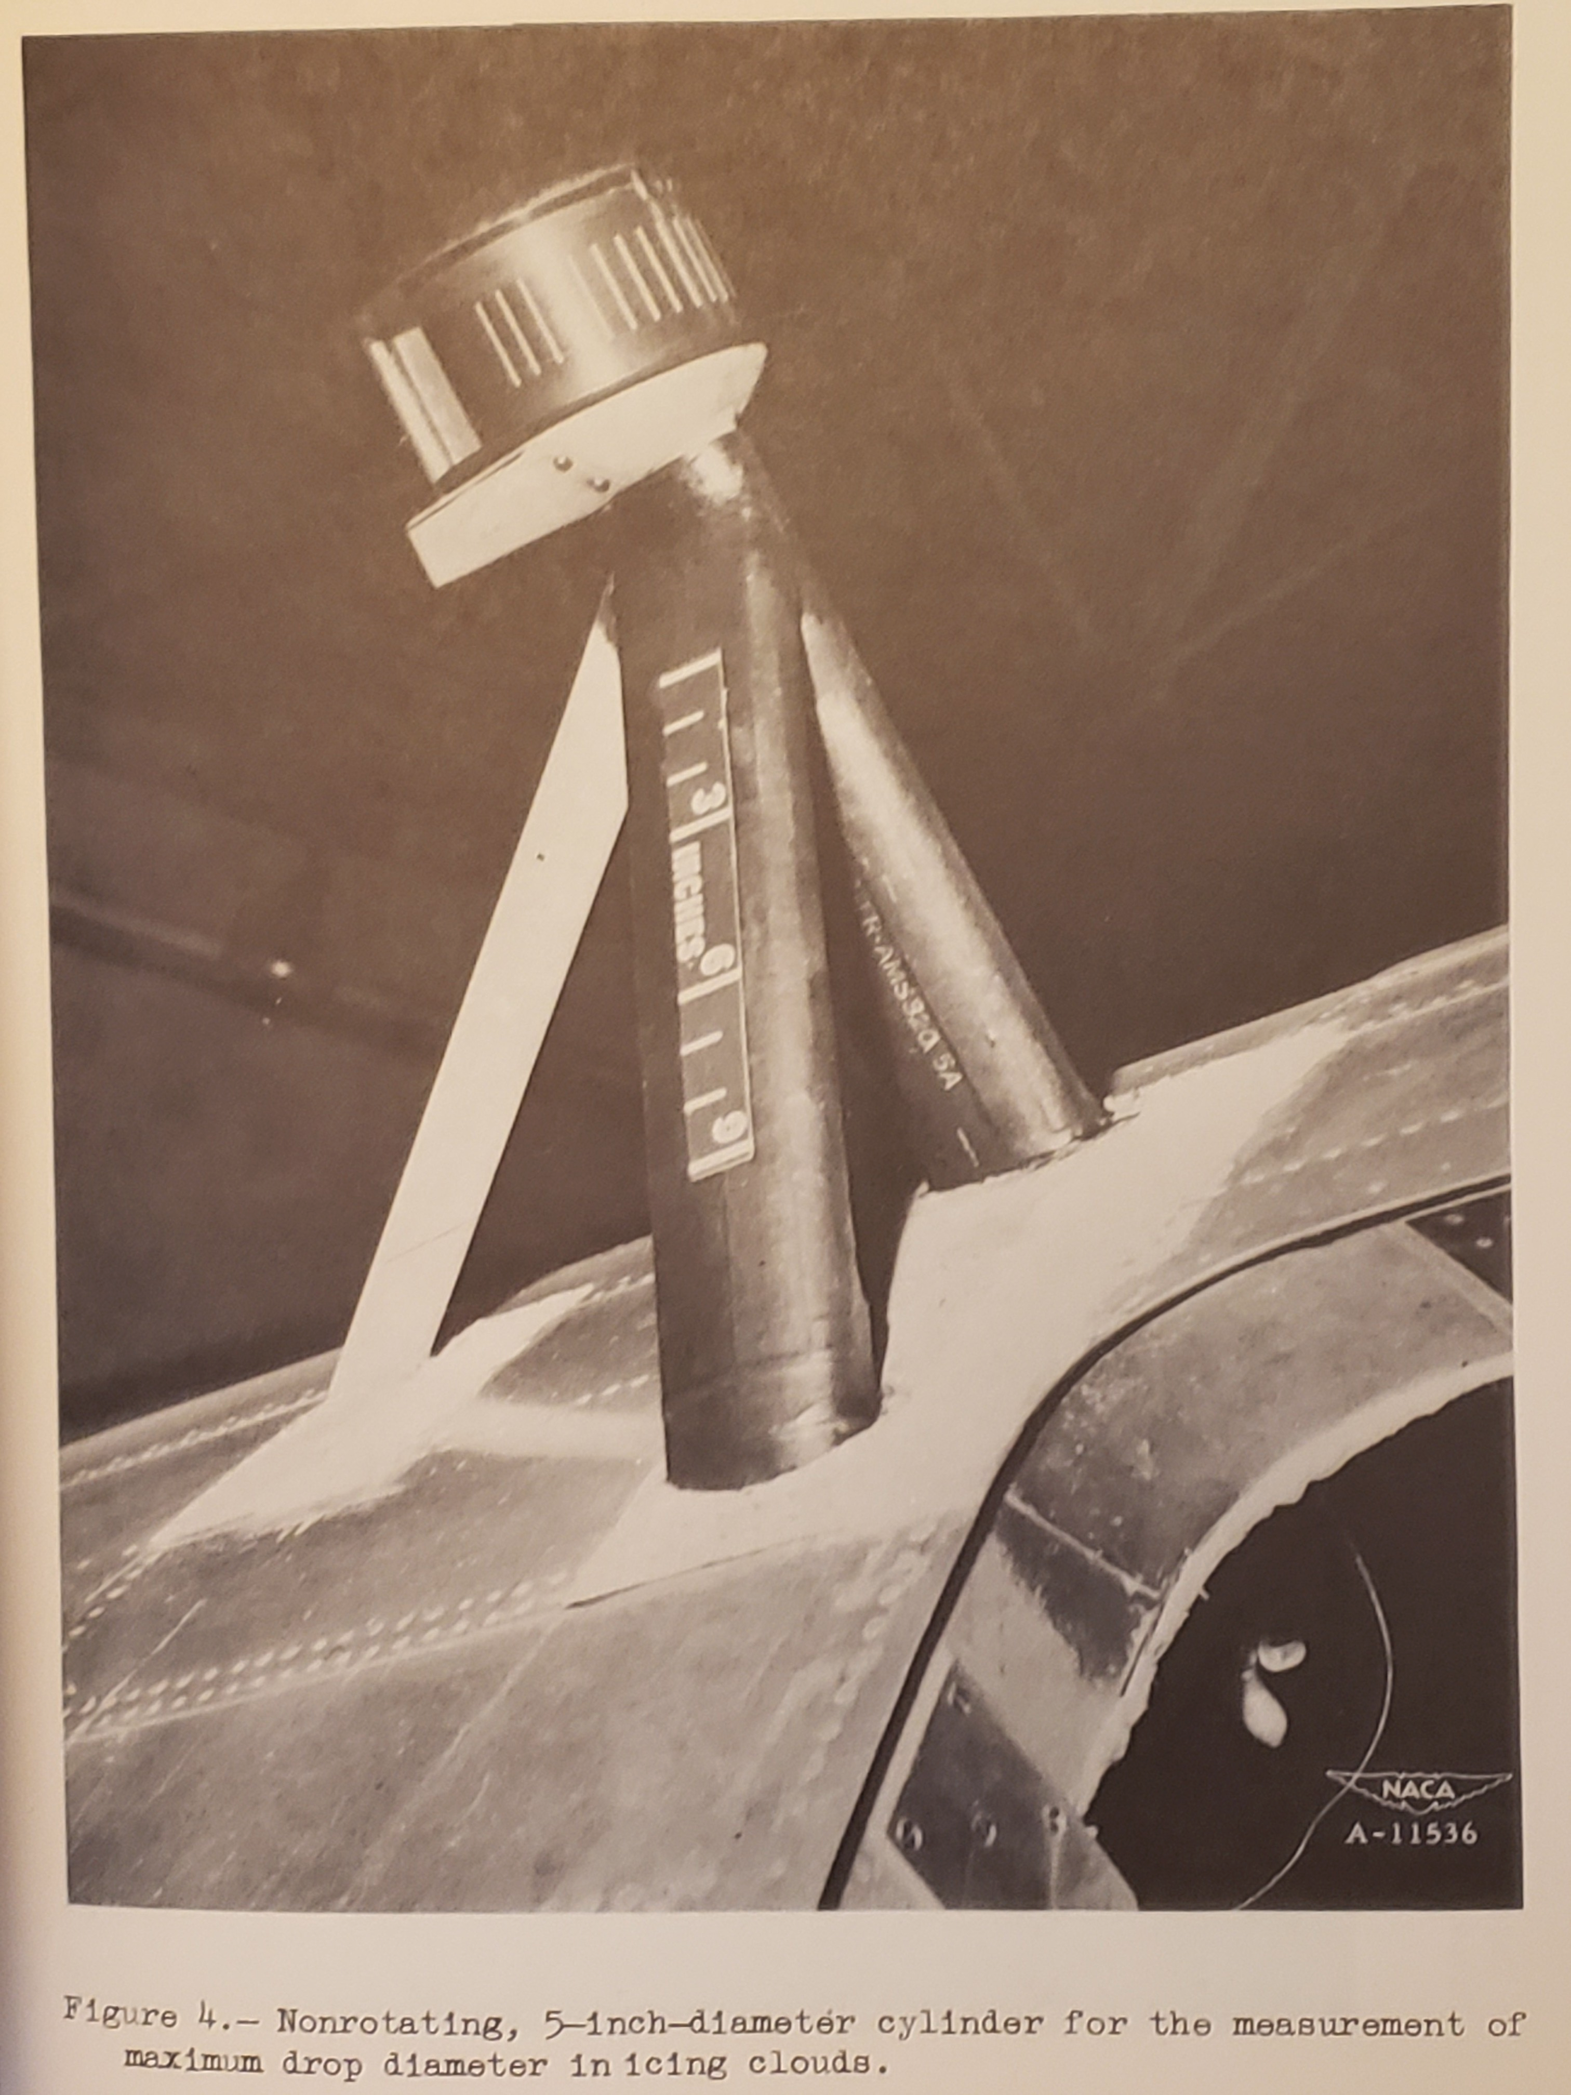
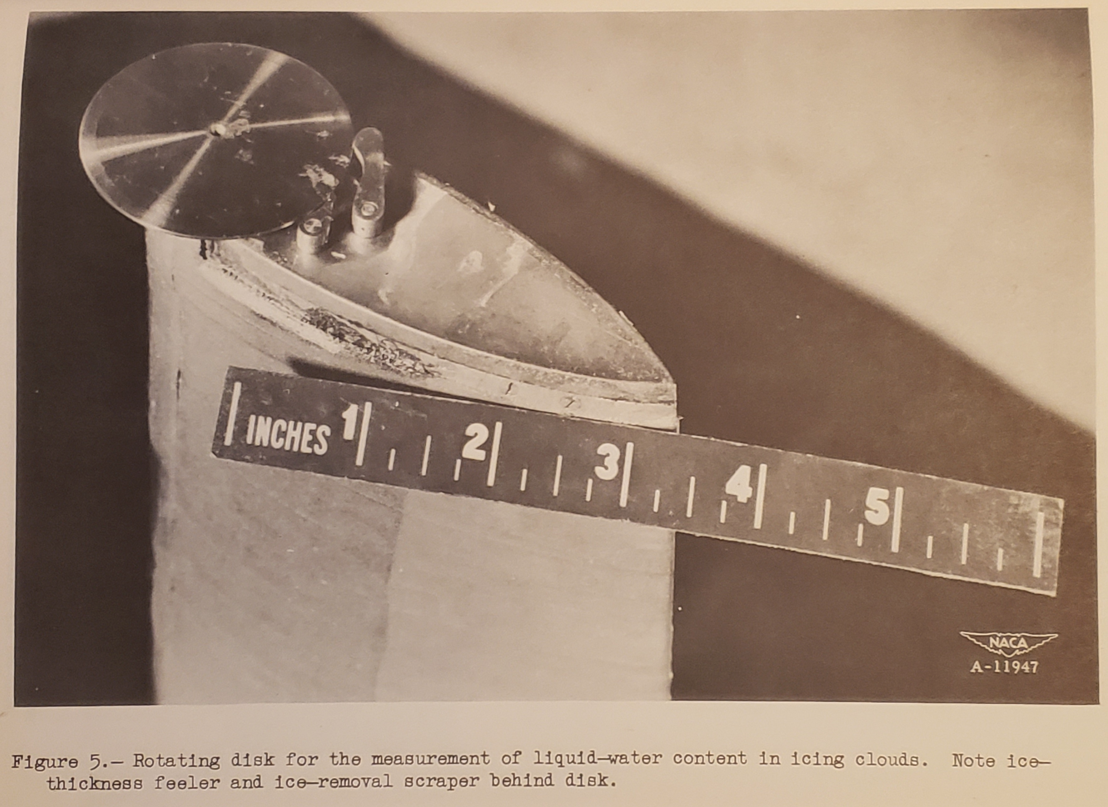
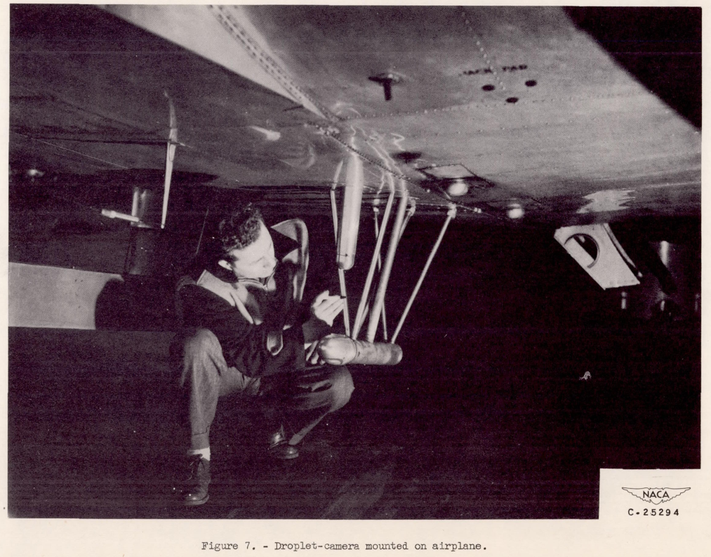
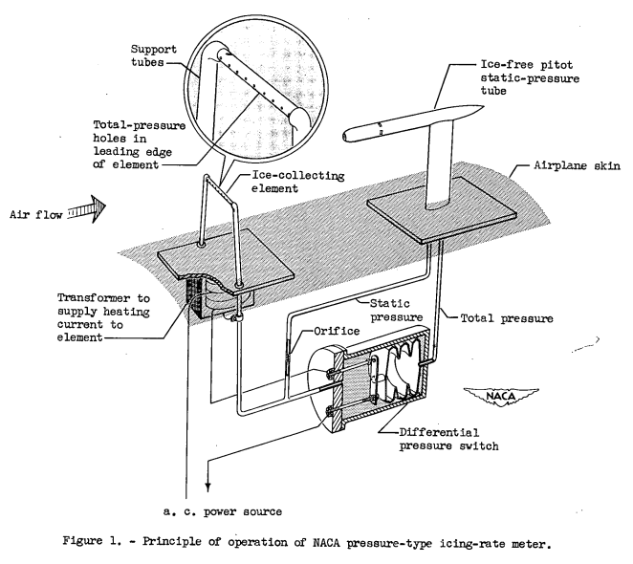
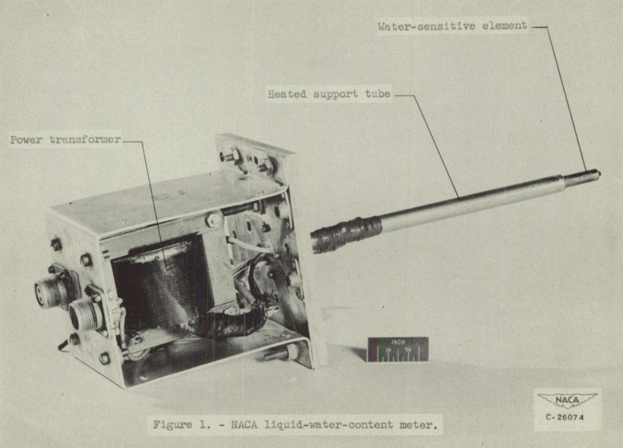
Instruments
"Progress ... has been handicapped by the lack of sufficient data on the meteorological factors."
Fixed Cylinder
Rotating Disc
NACA-TN-1855
NACA-RM-A9C09
NACA-RM-A9C09
Heated Probe
Water Drop Imaging
Pressure Recording
NACA-RM-E50J12A
NACA-RM-E50K01A
NACA-RM-E51E16
instruments icinganalysis.com
Notes:
Other instruments were used and developed in the NACA era. However, they were calibrated against the rotating multicylinder, and used as supplements, not the primary sources of data.
The pressure recording device was used in the 1950s to get long range icing exposure data.

Slide 13
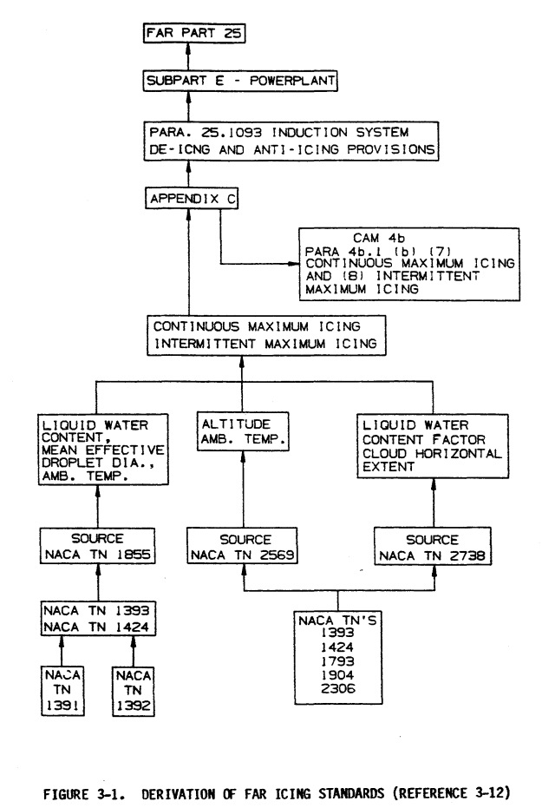
Data for Appendix C Icing definition
1964
“This research has progressed to a point where a tentative listing of icing conditions for design purposes can be attempted”
1955
NACA-TN-1855
Flight test data for Appendix C Figure 1 were complete by 1947. The rotating cylinder was the chief instrument used.
All flight tests that determined data for Appendix C were complete by 1951.
CAM 4b and Appendix C Figure 1 are very similar, with only minor formatting and unit differences.
1949
1947
1951
FAA Aircraft Icing Handbook (1991) apps.dtic.mil
Meteorology of icing icinganalysis.com
Notes:
“Everything was known by 1947”
Well, not quite. The LWC Concentration Factor and the altitude-temperature data came later, 1951.

Slide 14
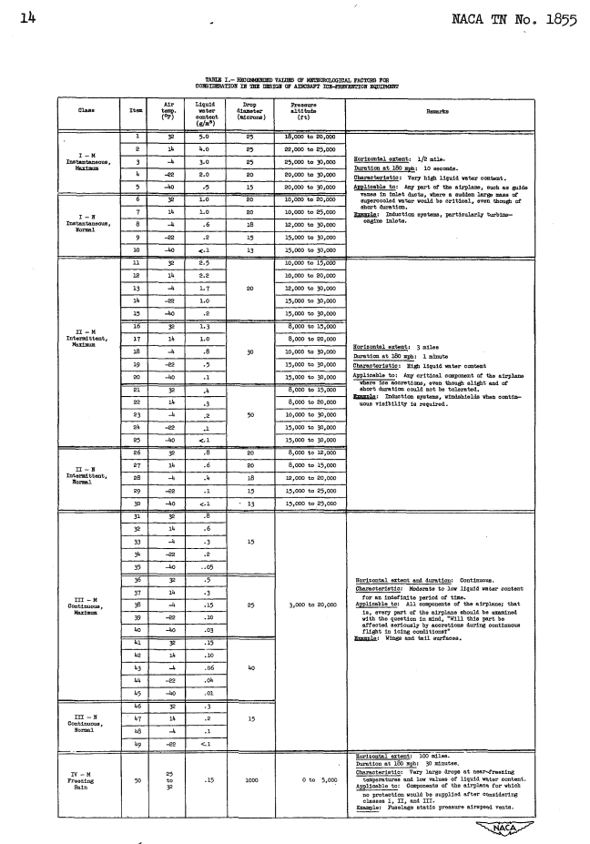
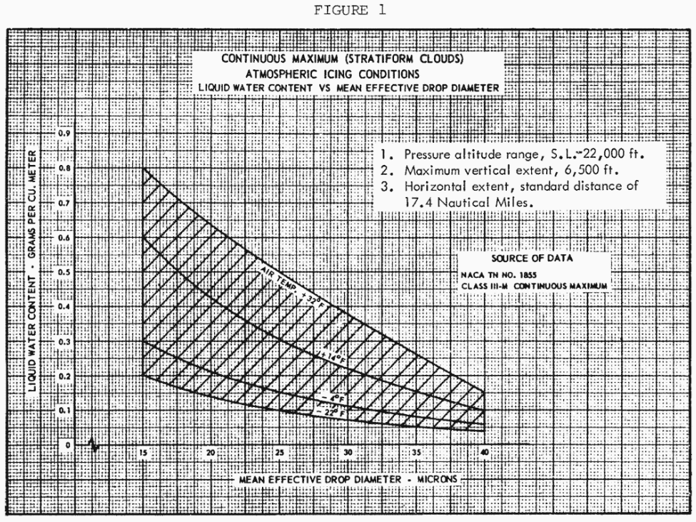
Data points on Appendix C, Figure 1
“The discipline had indeed been placed on a rational basis.”
NACA-TN-1855
CAM 4b 1955
CFR 25 Appendix C, 1964
NACA-TN-1855, 1949
ecfr.gov
-40F points not included
Notes:
The data points determined in 1949 map direct to the figure still used today in current icing regulations.
Note the “Freezing Rain” row at the bottom.
Supercooled Large Drop (SLD) icing icing regulations were not adopted until Amdt. 25-140, 79 FR 65528, Nov. 4, 2014 (not quite the same as the freezing rain data).

Slide 15
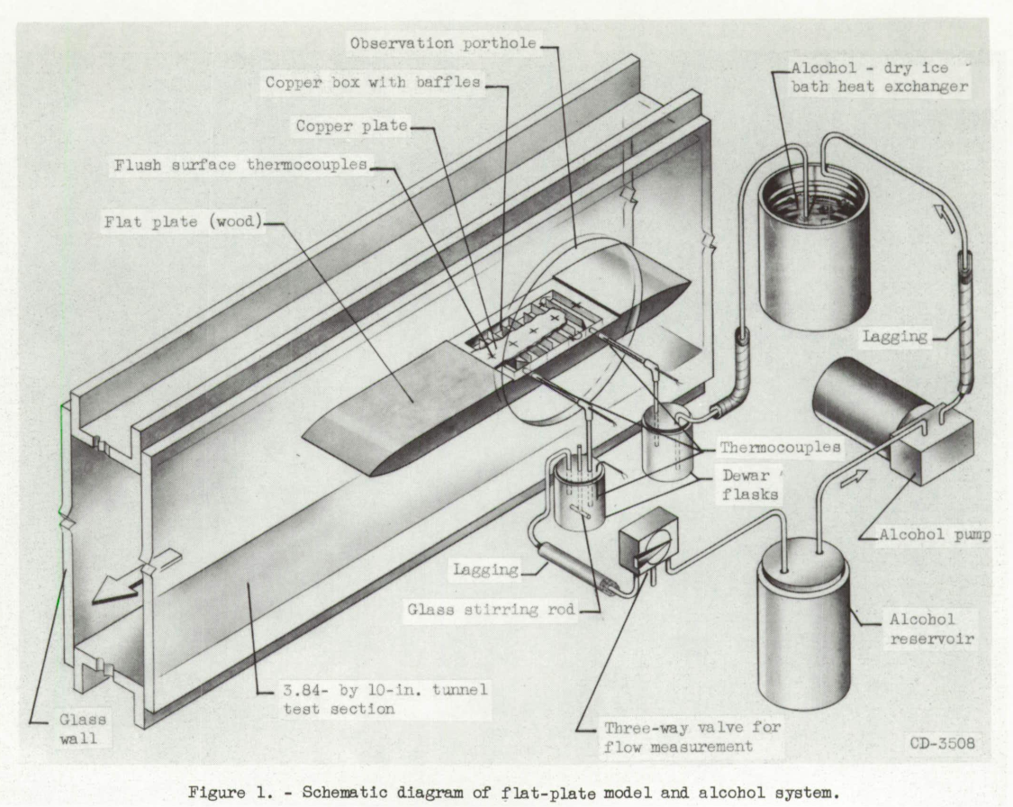
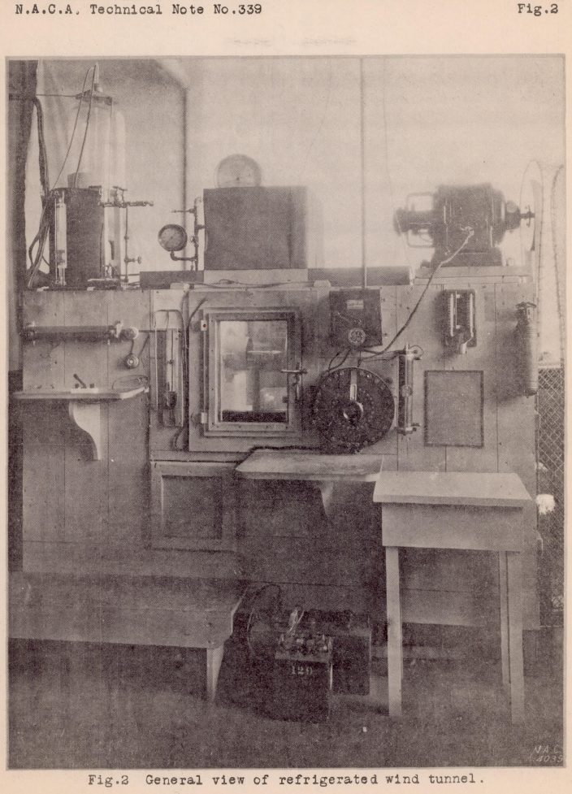
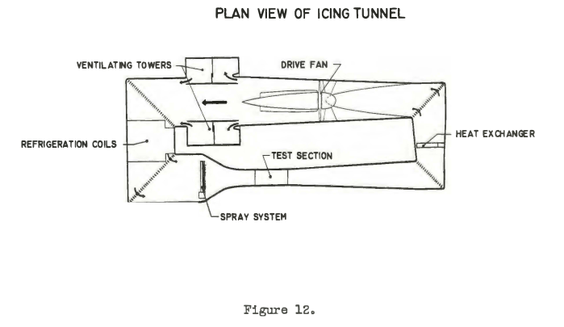
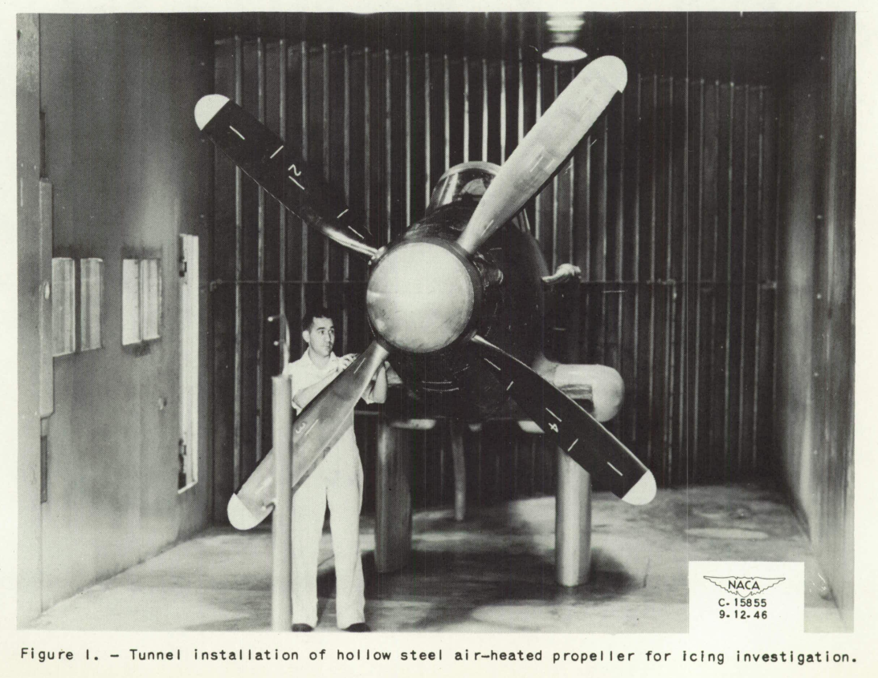
Icing Wind Tunnels
NACA-TN-339
NACA-TN-3104
Refrigerated Wind Tunnel at Langley Memorial Aeronautical Laboratory, 1930
3.84 x 10 inch tunnel, 1954
Icing Research Tunnel at NACA Lewis,
1944
P-39 in IRT, 1946
NACA-TN-1586
"An International Historic Mechanical Engineering Landmark ICING RESEARCH TUNNEL" www.asme.org
Icing wind tunnels icinganalysis.com
Notes:
The Refrigerated Wind Tunnel investigated ice phobic materials and large drop icing.
The 3.84 by 10 inch tunnel investigated trans-sonic icing.
The IRT has had many uses over the decades.
The ASME recognizes it as a historic place.
However, the icing tunnels were not the largest contributors to ice protection development (flight tests and analysis were).

Slide 16
“Selected Bibliography of
NACA-NASA Icing Publications”
First published in 1969, it was part of FAA AC 20-73 “Aircraft Ice Protection” until 2006.
This established a common, expected knowledge and nomenclature of aircraft icing.
132 publications in 16 categories:
Meteorology of Icing Clouds
Fundamental Properties of Water
Meteorological Instruments
Impingement of Cloud Drops
Propeller Ice Protection
Induction System Ice Protection
Turbine-Type Engine and Inlets
Wing Ice Protection
Windshield Ice Protection
Cooling Fan Ice Protection
Radome Ice Protection
Antenna Icing
Inlet and Vent Ice Protection
Jet Penetration
Heat Transfer
Miscellaneous
Blog post with more information on the Bibliography: icinganalysis.com
Notes:
My mentors were well versed in the “Selected Bibliography”

Slide 17
A Legacy: Design Manuals
The lessons learned from the NACA era have been encapsulated in design manuals, which are still used today.
“Engineering Summary of Airframe Icing Technical Data” FAA ADS-4, 1964 apps.dtic.mil
While published after the NACA era, it was included in the “Selected Bibliography”. Half of the references are NACA publications, and most of the others are from the NACA era.
“Ice, Frost, and Rain Protection”, SAE Aerospace Applied Thermodynamics Manual, 1969 (regularly updated) sae.org
This also still includes much data from the NACA era.
“Aircraft Icing Handbook, Volume I.” DOT/FAA/CT-88/8-1 (1991) apps.dtic.mil (there are also volumes II and III apps.dtic.mil apps.dtic.mil)
Some of the sections are revised from ADS-4, and so contain much data from the NACA era. There was a perhaps little-known update in 1993 apps.dtic.mil, but no updates since then.
Design manuals icinganalysis.com
Notes:
My mentors were well versed in the design manuals.

Slide 18
Some Areas of Continuing Research
Applicable publications
Blog posts
Large drop icing
Low ice adhesion coatings
Ice shape characterization
NACA-TN-1855
NACA-TN-339
SLD in icing tunnels icinganalysis.com
NACA-TN-313
NACA-TN-339
NACA-TN-339 review icinganalysis.com
NACA-TN-313
NACA-TR-446
Ice shapes and their effects icinganalysis.com
Notes:
The ongoing AIAA Ice Prediction Workshop is looking at ice shape characterization.

Slide 19
More information
"... the recommendation was made that before attacking what appeared to be a new icing problem we should study the icing work of the 1940's and 50's."
NASA-TM-81651
Lew Rodert, Epistemological Liaison, and Thermal De-Icing at Ames, NASA SP-4219, history.nasa.gov
“We Freeze to Please”: A History of NASA’a Icing Research Tunnel and the Quest for Flight Safety ntrs.nasa.gov
"Bringing the Future Within Reach: the NASA John H. Glenn Research Center", NASA-SP-2016-627 history.nasa.gov
Atmosphere of Freedom: Sixty Years at the NASA Ames Research Center NASA SP-4314
"The Wind and Beyond: Journey into the History of Aerodynamics in America, Volume 2, Reinventing the Airplane.", NASA-SP-4409, 2007. (Especially the "Heat Against Ice" excerpt, p. 506-518.) history.nasa.gov
"Engines and Innovation: Lewis Laboratory and American Propulsion Technology". NASA SP-4306, by Virginia P. Dawson, 1991 ntrs.nasa.gov, especially the chapter "Operations Research".
NTRS - NASA Technical Reports Server ntrs.nasa.gov (includes most of the NACA publications)
“Blast from the Past” NACA Icing Publications icinganalysis.com (reviews of NACA icing publications)

Slide 20
Abstract
"Aircraft Ice Protection in the NACA Era 1915 to 1958"
The National Advisory Committee for Aeronautics (NACA) studied aircraft icing through much of its history.
Early studies often looked at direct solutions for icing problems, but were hampered by limited knowledge of icing conditions. Largely “cut-and-try” engineering achieved test aircraft with complete ice protection by 1941.
These flight test aircraft, along with improved icing conditions measurement instrumentation, established much of the modern icing design conditions definition by 1949.
Several areas of icing addressed in the NACA era are still being studied today.

